Slide 1

AQua: A Solar-Powered Water Quality Monitoring and Recording System
Researchers:
Daligdig, Arianne Dale
Fuentespina, Jane
Notes:
Good Morning Ma’am and Sir. I am Jane T.Fuentespina. And my partner is Arianne Dale O. Daligdig. And I will present to you the introduction, SOP, Significance, and the Scope and Limitation: Our research is : AQua: A Solar-Powered Water Quality Monitoring and Recording System

Slide 2

Introduction
Aquaculture
Globally - 179 million metric tons of fish were produced, of which 82 million were produced by aquaculture (FAO, 2020).
Philippines - 525.24 thousand metric tons volume of harvest
decreased by 0.2% from the 526.05 thousand metric tons (PSA, 2021).
Mindanao - about 2,869.78 metric tons were produced from aquaculture fisheries
15.2% lower compared to the catch of 3,382.20 metric tons (PSA-SOCCSKSARGEN, 2020).
Notes:
Aquaculture is one of the most booming industries in many nations globally, as demand for fish and fish-prepared foods grows every day. In 2018, 179 million metric tons of fish were produced, of which 82 million were produced by aquaculture (FAO, 2020). (Food and Agriculture organization)
In the Philippines during the first quarter of 2020, the volume of harvests from the aquaculture farms reached 525.24 thousand metric tons. It decreased by 0.2 percent from the 526.05 thousand metric tons produced during the same period in the previous year (PSA, 2021).
In Mindanao specifically in Region 12, about 2,869.78 metric tons were produced from aquaculture fisheries in the 2nd quarter of 2020 and this is about 15.2 percent lower compared to the catch of 3,382.20 metric tons in the same quarter last year (PSA-SOCCSKSARGEN, 2020).

Slide 3
According to BFAR-PHILMINAQ, the fish perform all its physiological activities in the water
Thus, water quality is the determining factor in the success or failure of an aquaculture operation.
At present, aqua farmers rely on manual testing to determine water conditions
Notes:
The aquaculture industry is facing many problems; and it is due to the sudden climatic fluctuation that leads to changes in water quality parameters.
According to BFAR-PHILMINAQ, the fish perform all its physiological activities in the water – breathing, excretion of waste, feeding, and reproduction.
Thus, water quality is the determining factor in the success or failure of an aquaculture operation. The continued degradation of water resources due to anthropogenic sources necessitates an improvement in sites for aquaculture using water quality as a basis.
At present, aqua farmers rely on manual testing to determine water conditions; and it consumes time and produces inaccurate readings because water quality parameters may alter with time.
These problems being faced by the Philippine government stem from a lack of clear responsibilities, overlapping institutional boundaries, duplication of work, and a lack of coordination among involved institutions. All water quality monitoring programs in the country are constrained somehow by available laboratory facilities, instruments, transportation, and human resources; and may collect data primarily through direct sampling or limited water quality parameters. (Japitana et al., 2018) Specific information about water conditions, which is required to develop management strategies, is particularly scarce. (Deutsch et al., 2005)
With this, the researchers proposed a study that builds a portable and solar-powered on-site water quality monitoring and recording system that can deliver real-time data to the aqua farmers and government officials and record the current environmental status of the aquaculture sites for further analysis.
This project will help prevent the water parameters from fluctuating to a dangerous level that affects the mortality rate of the organism. Also, this will help in addressing the decline of the production of fish in selected aquaculture sites in Mindanao, Philippines.

Slide 4

Power supply
traditional water quality monitoring systems
slow fish growth and fish kills in fisheries
AQua
Notes:
*Power supply has become an increasing problem in some of the existing water quality monitoring systems, where sensor nodes are deployed across several sites and can constitute the system's bottleneck. Using wires to connect nodes to power lines nearby is not practical because the nodes usually distribute in remote places where the total expense in connecting all these nodes is unbearable. Another option is to solely utilize a battery. The benefits are evident, but batteries have a short lifespan and cannot last for lengthy periods. Replacing exhausted batteries regularly is time-consuming. Using a solar panel to power the sensor node and a battery to recharge when solar power is insufficient (such as at night), this solution will save time and effort while also making the system more deployable.
*Apart from that, traditional water quality monitoring systems rely on short-range, high-power wireless technologies, which are inconvenient for wireless sensor nodes in a Wireless Sensor Network (WSN).
*Furthermore, slow fish growth and fish kills in fisheries are problems that every fish farmer faces in the aquaculture industry. Water quality is a critical factor that must be monitored from time to time when culturing any aquatic organism; however, most fish farmers do not consider it because traditional water testing and water sensors are done manually, expensive and difficult to use.

Slide 5
Energy-Efficient
Lower latency
Scalable
Notes:
As a result of these concerns, this proposed project provides a device designed to address energy difficulties in WSNs, as well as a low-cost, low-power, long-range, scalable water quality monitoring strategy based on the Zigbee protocol, which is significantly more efficient than many current systems. Furthermore, this device offers lower latency network connection which means it has very small delay times. It is very efficient when it comes to delivering real-time data.
This novel system that we proposed will speed-up the time needed to test the water parameters and has several advantages, including no carbon emissions, low power consumption, greater flexibility in deployment at a remote site, and so on.

Slide 6
develop a real-time water quality progress report for water treatment ensuring a safe natatory environment for aquaculture using Raspberry Pi.
Objectives
Notes:
2 objectives (General and Specific)
The main objective of this research is to develop a real-time water quality progress report for water treatment ensuring a safe natatory environment for aquaculture using Raspberry Pi.

Slide 7
Design and construct the AQua device
Monitor and measure the water parameters
Assess the accuracy of the results
Provide local power supply and collect the data
Simulate and analyze the quality parameters for quality control
Notes:
1.3.2 Specific Objectives
This research project aims to achieve the following:
Design and construct the AQua device using Raspberry Pi.
Monitor and measure the water pH, temperature, and turbidity using available sensors at remote places.
Assess the accuracy of the results when applied to a wide range of water conditions.
Provide local power supply to sensor nodes using solar energy and collect the data from various sensor nodes and send it to base stations by a wireless channel which are connected using Wireless Sensor Network technology like Zigbee.
Simulate and analyze the quality parameters for quality control using ThingSpeak and publish the corresponding record over the web for public information and further assessment of water resources.

Slide 8
Aquaculturists
Future Researchers
University
Researchers
Significance
Notes:
Significance of the Study
This research study, AQua: a solar-powered water quality monitoring and recording system is proposed in order to be significant to the following:
To Aquaculturists. The device will help the aquaculturist by delivering real-time data to the aqua farmers and government officials and record the current environmental status of the aquaculture sites for further analysis. This project will help prevent the water parameters from fluctuating to a dangerous level that affects the mortality rate of the organism. Also, this will help in addressing the decline of the production of fish in selected aquaculture sites in Mindanao.
To the Future Researchers. They can use this study as their reference to additionally extend the usage of Zigbee module, Raspberry Pi and ThingSpeak IoT in water quality monitoring and in other fields as well.
To the University. This study will be of use to the Mindanao State University particularly engineering students who suppose they might be intrigued and inspired to invoke more splendid thoughts, characterizations of innovative progressions that would be of future use to the College of Engineering with accomplishing its objective and to further develop the said water quality monitoring system.
To the Researchers. This study will be an opportunity for them to apply the knowledge and illustrations gained from subjects related to this study and help them further practice their decisive reasoning. Moreover, this will also give the researchers to be more exposed and gain experience as they need to be focused and hands-on in this study.

Slide 9
Scopes and Delimitations
Raspberry Pi
Zigbee module interface
pH, temperature, and turbidity of the water
Department of Environment and Natural Resources' (DENR) standard levels
Notes:
*This project's main objective is to create an onsite and solar-powered IoT-based water quality monitoring and recording system using a Raspberry Pi.
* It focuses mainly on the sensor's and device's accuracy in contrast to typical laboratory equipment and the speed and range of data transmission via Zigbee module interface.
*Only the pH, temperature, and turbidity of the water will be measured by the device.
*The study's threshold values are solely based on Department of Environment and Natural Resources' (DENR) standard levels. This device is solely for determining the water quality of aquaculture industries in selected sites in Mindanao.

Slide 10
System Design and Layout
Methodology
Notes:
The goal of the research is to develop an onsite and solar-powered water quality monitoring and recording system. To accomplish this, the development was divided into 4 parts: (1) The designing of the device, (2) the assembly of the main circuitry, (3) the construction of the device chassis, and (4) the accuracy tests.

Slide 11
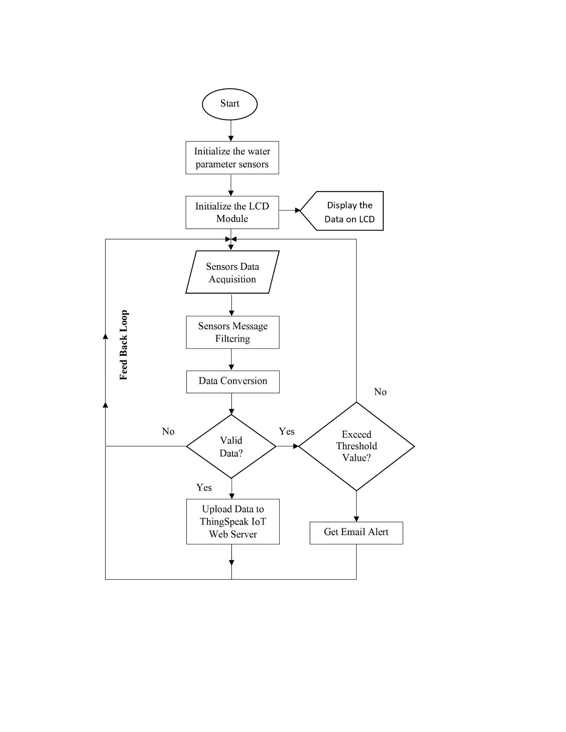
Notes:
The water parameter sensing node integrates sensors in real-time water quality monitoring and recording systems. These sensor values are displayed through the LCD monitor. Moreover, the data collected by the sensors is sent to the base stations by a wireless sensor network technology called Zigbee then transfers it to the ThingSpeak server through the ESP32 Wi-Fi gateway module. The quality parameters acquired are then stored, simulated and analyzed for quality control using ThingSpeak and publish corresponding records over the web for public information and further assessment of water parameters. An alarm notification will be sent through email using MATLAB or IFTTT programming if any of the parameters' values exceed the permissible levels.

Slide 12
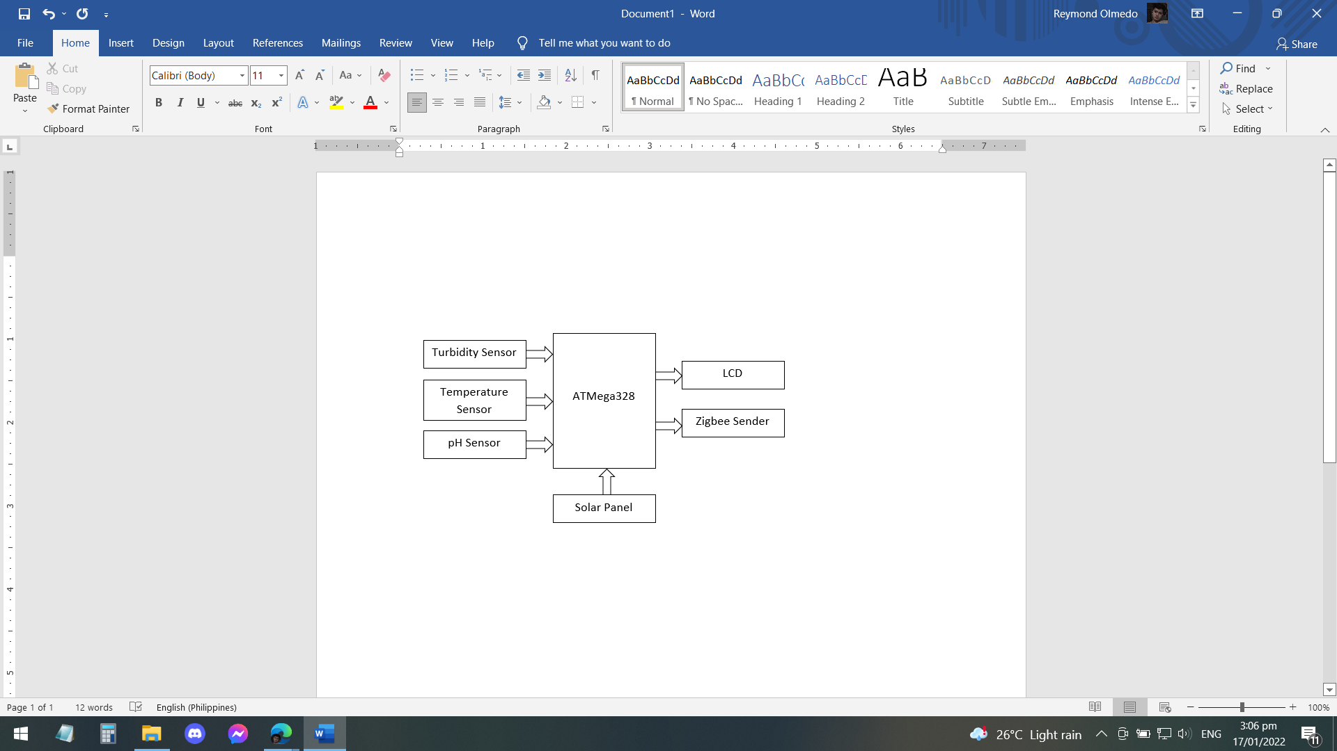
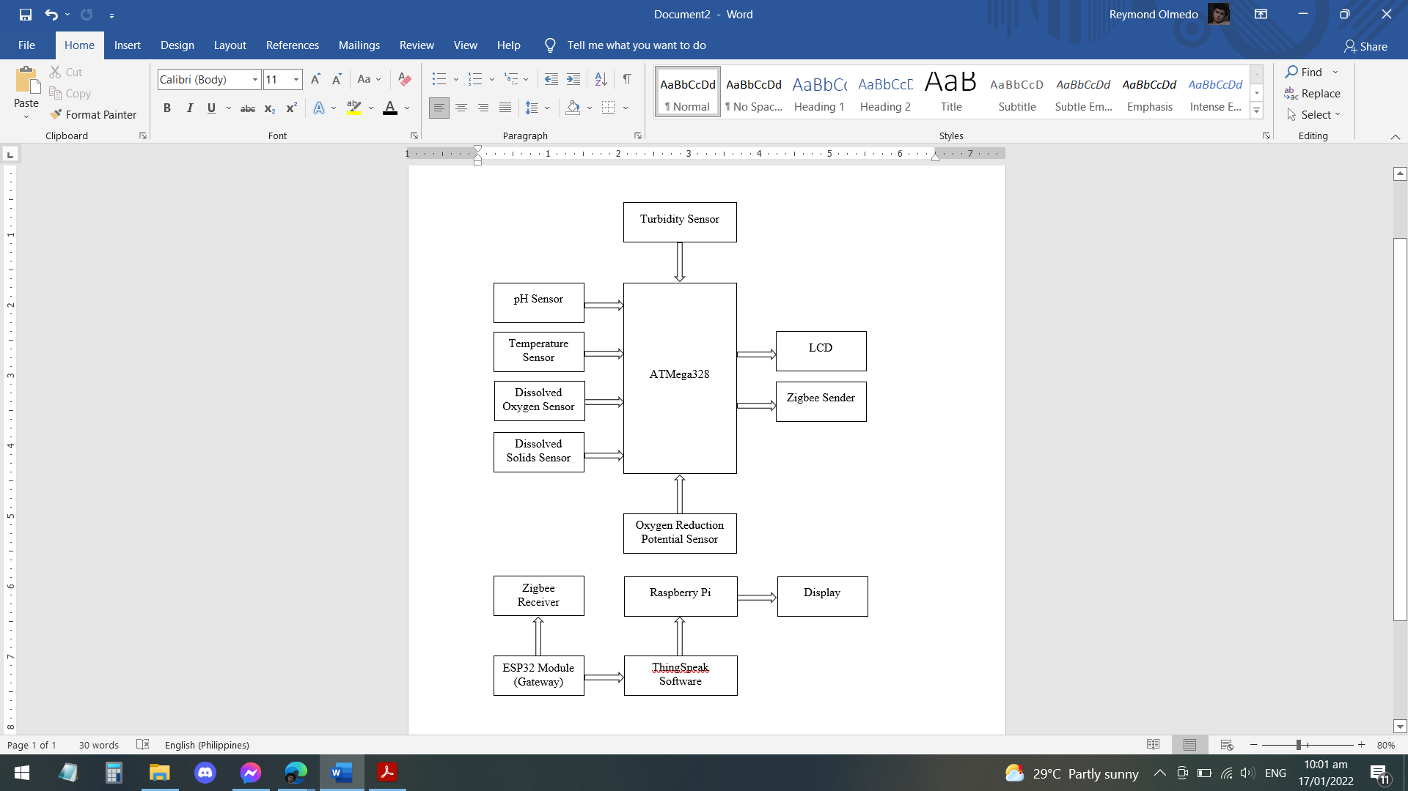
Notes:
The whole block diagram of the study is shown in Figure 3.2. The solar cell power supply gives power to the sensors, Raspberry Pi, ATMega328 microcontroller, ESP32 gateway module, and Zigbee module. The sensors are the pH sensor, temperature, and turbidity sensor. The Zigbee module will be used to connect the nodes and base station. The data obtained by various sensors on the node side will be sent to the base station where the data can be displayed in a visual manner and analyzed using ThingSpeak.

Slide 13
Construction & Assembly
Methodology

Slide 14
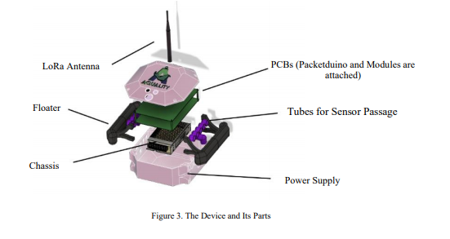
Notes:
The AQua device contains three sensors (namely the pH sensor, the temperature sensor, and the turbidity sensor) which are connected to one main microcontroller (Raspberry Pi) together with the Zigbee module. The case of the device is box-shaped and will be made out of acrylic due to its low cost material, water resistance ability, and well-known availability. It houses all the main parts of the device. The two tubes on each side function as a floating device. The pipes on each side are outlets for the sensor and are covered by mesh to avoid fish eating the sensors or bumping into them. Figure 3.3 shows the inspiration of the AQua device from Tolentino et al (2021) in relation to its illustration and its parts.

Slide 15
Technical Descriptions
Methodology

Slide 16
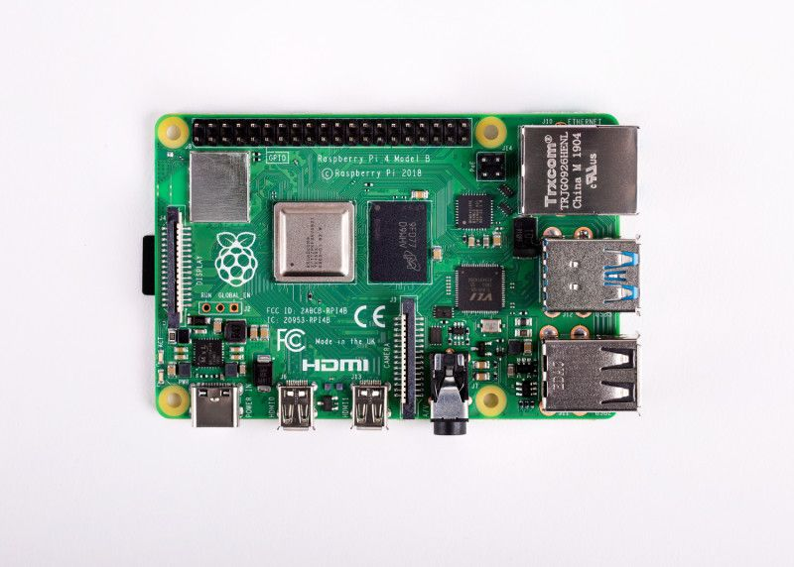
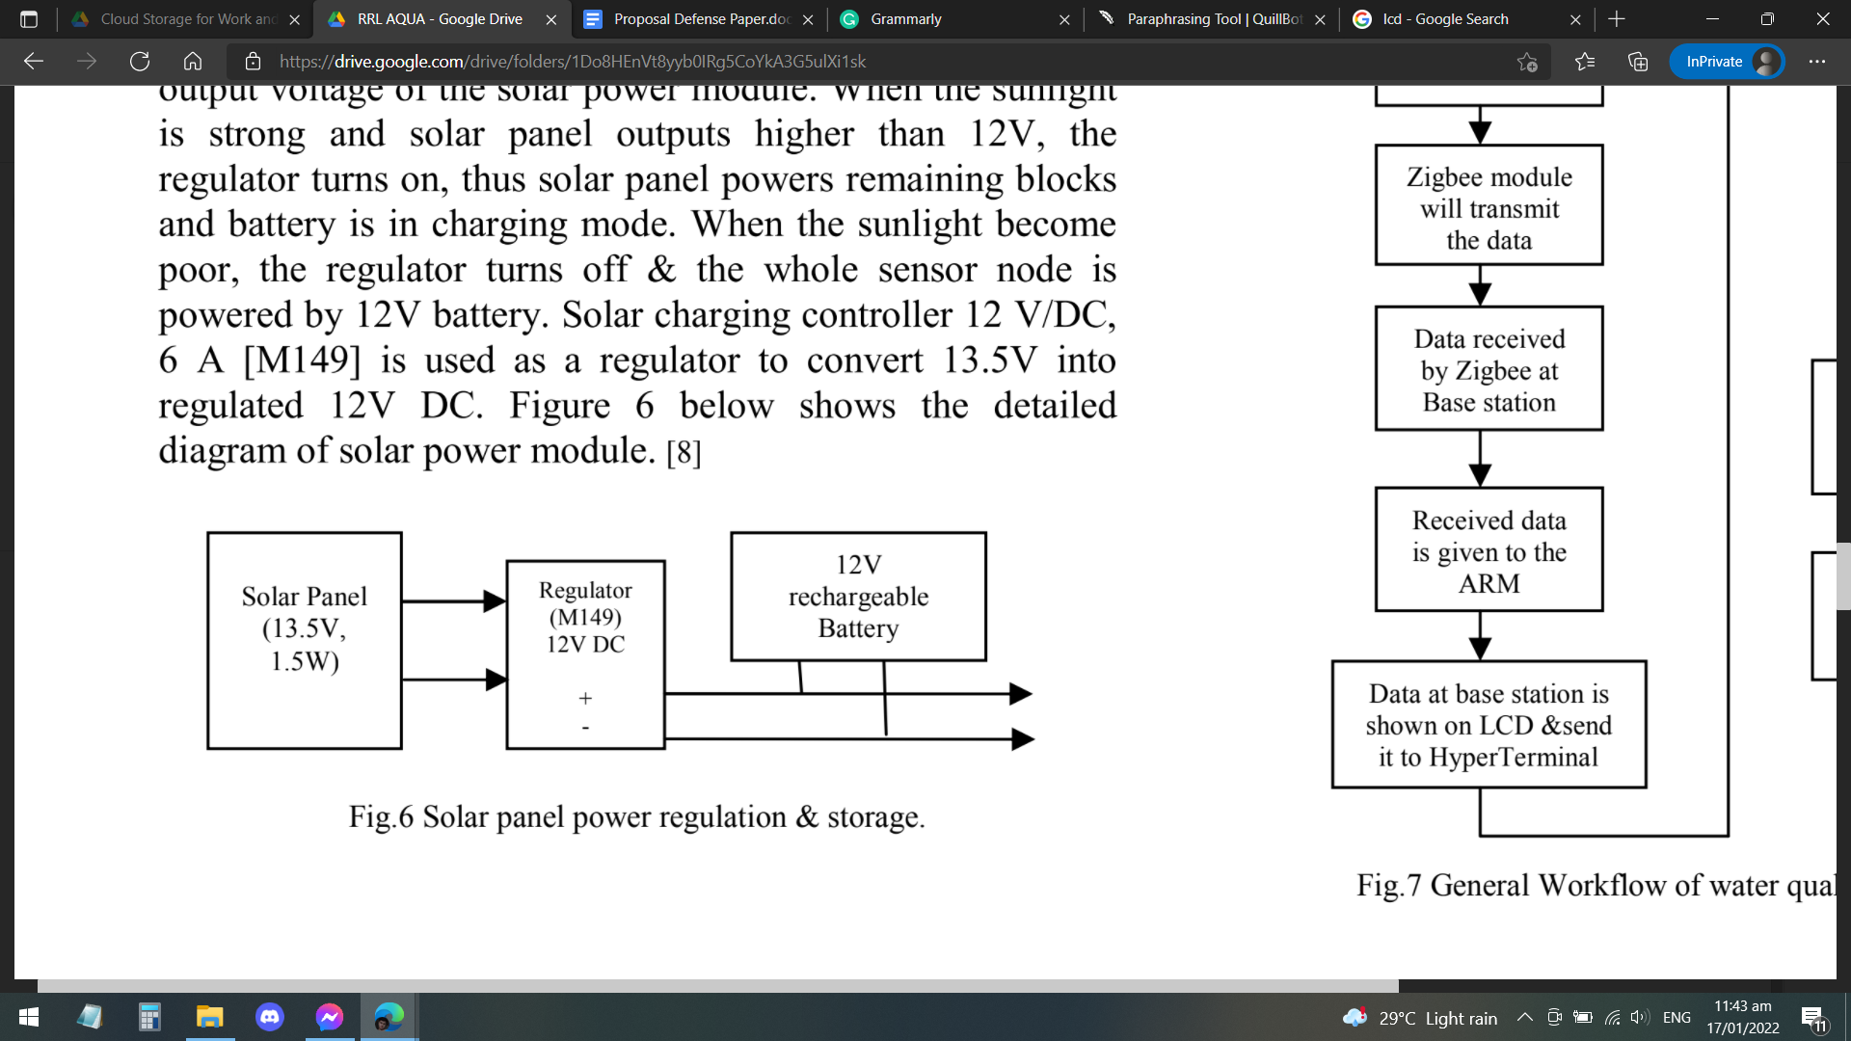
Raspberry Pi
Solar Panel Power Regulation and Storage

Slide 17
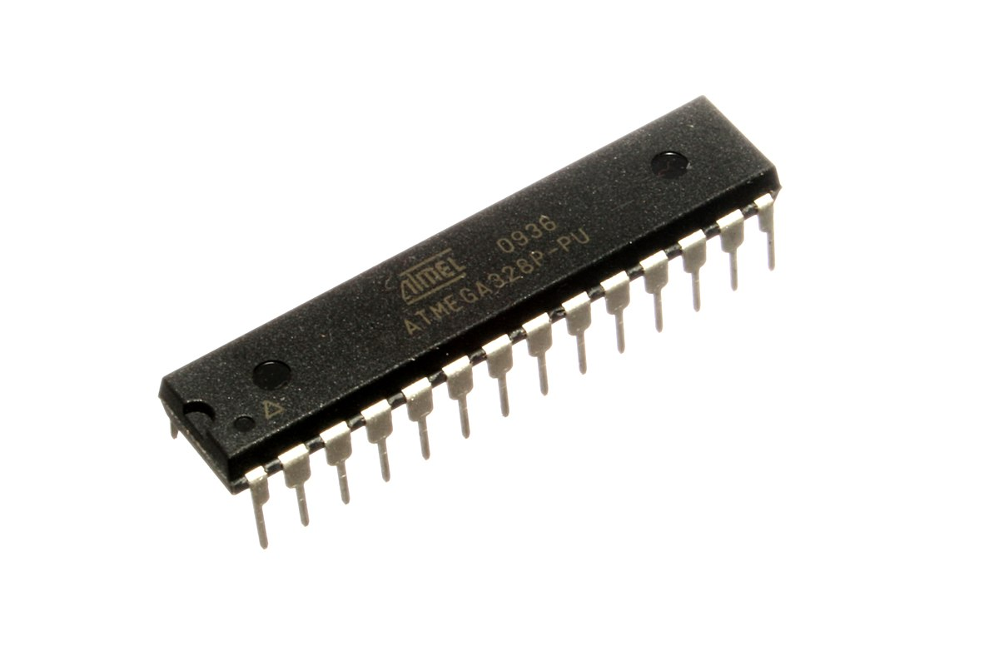
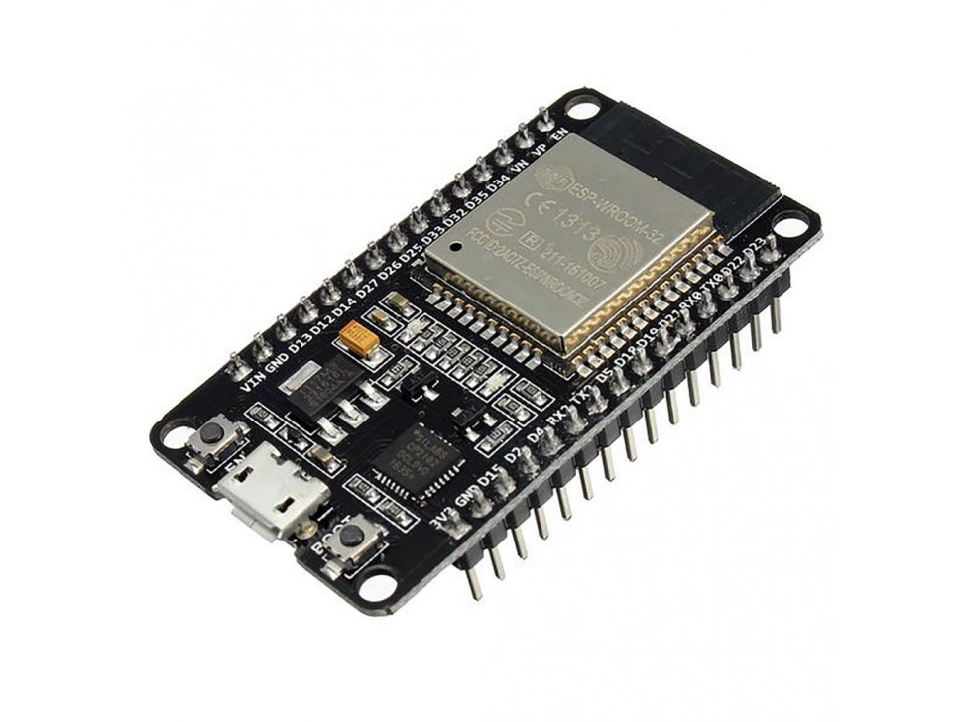
ATMega 328
ESP32 WiFi Module

Slide 18
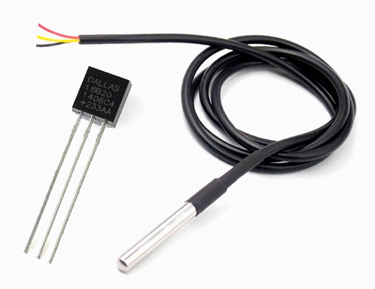
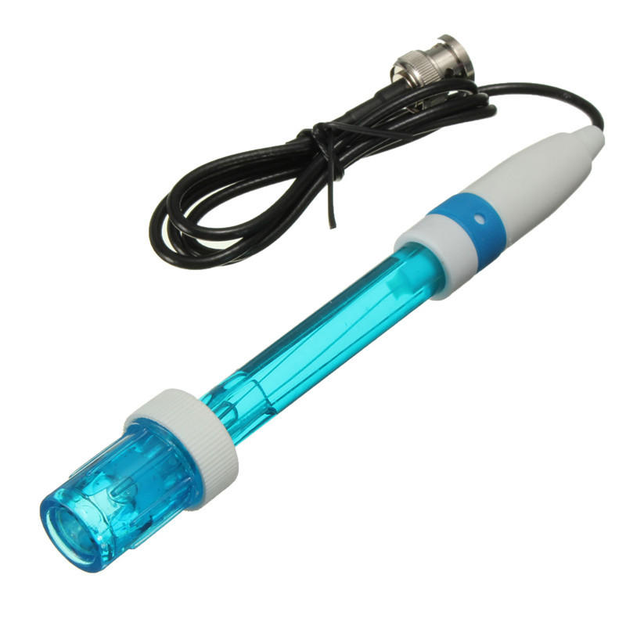
DSI8B20 Temperature Sensor
pH Sensor Module E201-C-9

Slide 19
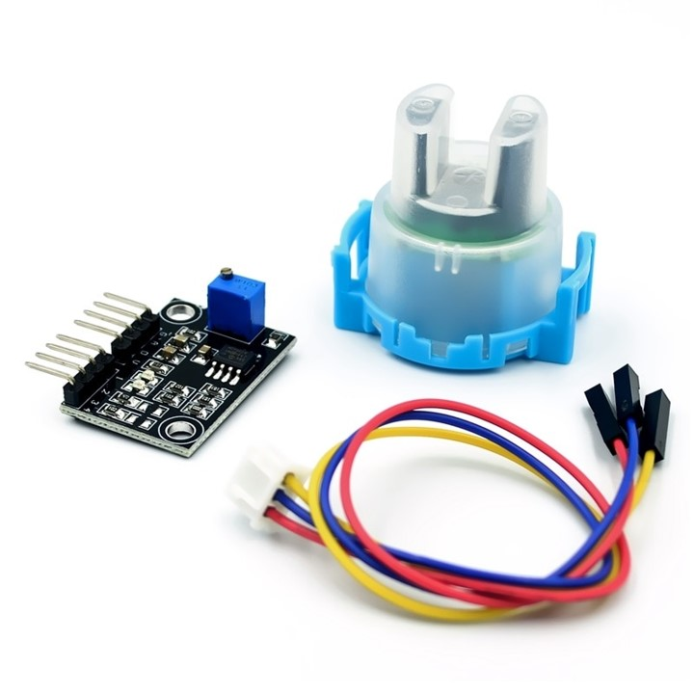
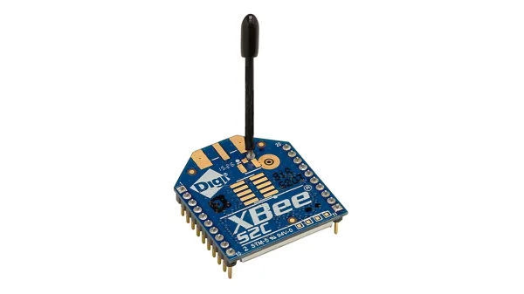
TS-300B Turbidity Sensor
Zigbee Module

Slide 20


Slide 21
Device Accuracy Test
Methodology
Notes:
The collected data was compared against the traditional way of data gathering for each parameter to ensure that the results were credible. To be considered accurate, each datum obtained by the gadget must be within 5% of the traditional method's test findings (Alave et al, 2020).

